Slide 1
Lecture 7: entering parenthood
SC22o5: Sociology of the family

Slide 2
Where we have been…
Introduction to sociology of the family
Family as a social construct
Normal family ideology
Conceptual frameworks in the analysis of the family

Slide 3
Where we are going…
Family Formation, Transitions, and Dissolution
Romantic love and courtship
Marriage and cohabitation
Gender and the division of labor
Entering parenthood (Today)
Divorce

Slide 4

Entering parenthood
The cultural importance of parenthood
The social transition to parenthood
Gender and parenthood

Slide 5
The cultural importance of parenthood
Notes:
Wedding creates couple, and child is presumed.

Slide 6
Pronatalism
Pronatalism
A cultural belief that married couples should reproduce or should want to reproduce
Pronatalism has its roots in Judeo-Christian tradition that depict children as “blessings” and childlessness as a curse or punishment
All societies, regardless of their economic or political systems, value childbearing but in different ways
Notes:
Encourage reproduction, and reinforce child as vital part of our survival. Pronatalism is in our society despite declining birth rate

Slide 7
Adoption and the primacy of genetic parenthood
In most cultures, the biological, genetic bond between parents and children is considered of paramount importance and forms the basis of “real” families
Consequently, adoption is sometimes considered a lesser form of parenting
Adoptees searching for their biological roots appeal to the cultural notion that our “real” identity is linked to shared genes
“Closed” adoptions and the cultural primacy of biological over adoptive parenthood
Notes:
Adoption is seen as a lesser form of parenting.
Closed adoption due to the idea that the genetic bond will surpass the bond with adoptive parents.

Slide 8
Infertility
Infertility
Couples who want genetically related children but are unable to have them
Couples feel the stigma of infertility as deeply as they would feel the stigma of any other “abnormal” condition
Infertility is especially difficult for women
The availability of infertility treatment intensifies postnatalism
Notes:
Infertility does not have any visible sign, and the couple themselves know only.
Women are the one who feels more pressured, as women conform into their gender role of being a mother.
Escalating new methods for infertility. Insemination, in-vitro fertilization, surrogate motherhood.
Funding from the government, and trips are made to over the world. “reproductive tourism”
Difficult for couples to not reproduce, as those who reject these treatments are treated as objects of suspicions and pity.

Slide 9
Voluntary childlessness
Voluntary childlessness
Couples biologically capable of having children that choose not to do so
Voluntary childlessness challenges the commonly held assumption that childbearing is the appropriate course of action in marriage
Couples consistently opposed to having children are relatively rare due to the power of pronatalism norms
Notes:
Voluntary childlessness are associated with higher marriage satisfaction rate across all categories, but still frown upon by the society.
1 child is also increasing popular, and 2 child is the norm in Singapore (37% for 30-39, 44% for 40-50)

Slide 10
The social transition to parenthood
Notes:
Parenthood is a social role.

Slide 11
Social transition to parenthood
A child is a tangible symbol of love the couple share for each other
Children give the couple a sense of meaning and purpose
Children expand social networks by connecting the couple to other family members as well as the larger community
Many couples report that marital quality declines are children are born
Another recent study found that couples consider faithfulness, sexual compatibility, sharing household chores, adequate income, good housing, and shared interests more important contributors to a happy marriage than children

Slide 12
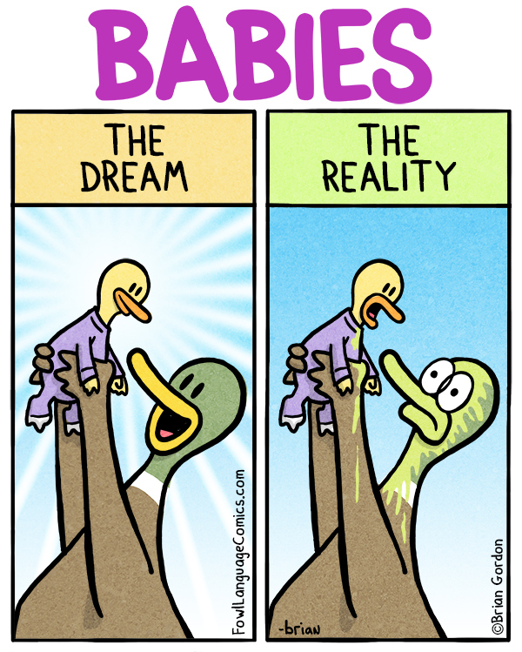
Social transition to parenthood
What makes the transition to parenthood so hard?
Parenthood is irrevocable
Most of the learning parents experience is on-the-job training
All this learning occurs within a framework of ambiguity
New ideology of equality
Parenting has become a private, rather than a community, obligation
Notes:
Most of the training about birthing process instead of the baby caring process/
Living in nuclear familes has led to private rearing of children

Slide 13
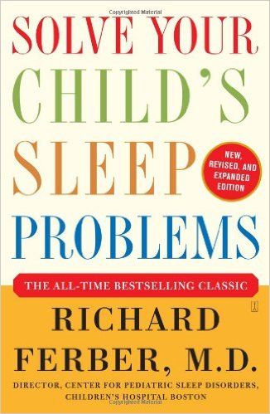
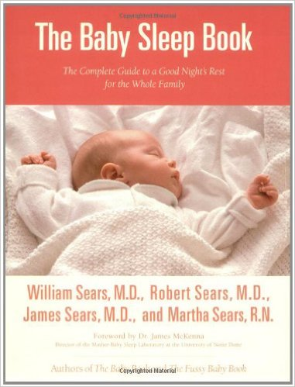
Social transition to parenthood
Cry it out method
No tears method
Notes:
No right or wrong, both methods prove to work for parents. Lasting efforts can’t be differentiated.

Slide 14
Social transition to parenthood
Parents must provide enough income and provide safe housing in neighborhoods with good schools
Parents must search exhaustively for childcare providers and continually monitor their quality
Parents must read and play music to their children daily to encourage brain development and constantly supervise their play
Parents must provide healthy, well-balanced meals and opportunities for exercise
Parents must protect children from dangers associated with unsafe water, pesticides on food, and exposure to sun
Parents are expected to monitor children watching TV or movies and control Internet usage to protect them from excessive violence, profanity, and sexually explicit images
Parents must teach children proper moral values and positive behaviors
When the children are older, parents are expected to know their friends and watch for signs of precocious sexuality, eating disorders, depression, drug use, or aggression

Slide 15
Gender and parenthood: Mothers

Slide 16
Biological Motherhood
Maternity
The state of being pregnant and giving birth
The assumption that maternity gives women not only the ability but also the desire to nurture
Alice Rossi (1977) argues mothering is instinctual
The majority of mothers instinctually cradle their infants in their left arm, where the infants can be closer to the sounds of the mother’s heartbeat
Mothers may be responding to something they have learned
Notes:
Alice Rossi (1977) “A Biosocial Perspective on Parenting.” Daedalus, 106 (2), pp. 1-31.
Infants are reassured by heartbeats

Slide 17

Biological motherhood
Not all women who give birth form nurturing bonds with their babies
For example, some German hospitals now offer drop boxes where women can place their unwanted babies anonymously without fear of prosecution
Even in our culture that places a premium on motherhood, not all women want to be mothers
According to Kathleen Gerson (1985), their decisions are influenced by a variety of social factors and experiences
Notes:
What are the social consequences of mothering?

Slide 18
Historical motherhood
John Gillis (1996) details the separation of maternity and motherhood in the 18th century
The belief that mother was not supposed to show affection toward her baby and her peripheral role after birth
Giving birth and giving nurture were also often incompatible for demographic reasons
Parents often place their children in foundling hospitals and orphanages because they could not afford to raise them
Notes:
John Gillis (1996) A World of Their Own Making: Myth, Ritual, and the Quest for Family Values.
Maternity and motherhood are associated today.
Will be looked upon with suspicions in 18th century if they have too much affection for the babies, but this trend is due to the high infant mortality rates and only half of the children live to 21, and most mothers die before children are grown up. Better for the child to have wealthier parents, and is not considered immoral. Thus separation of maternity and motherhood.

Slide 19
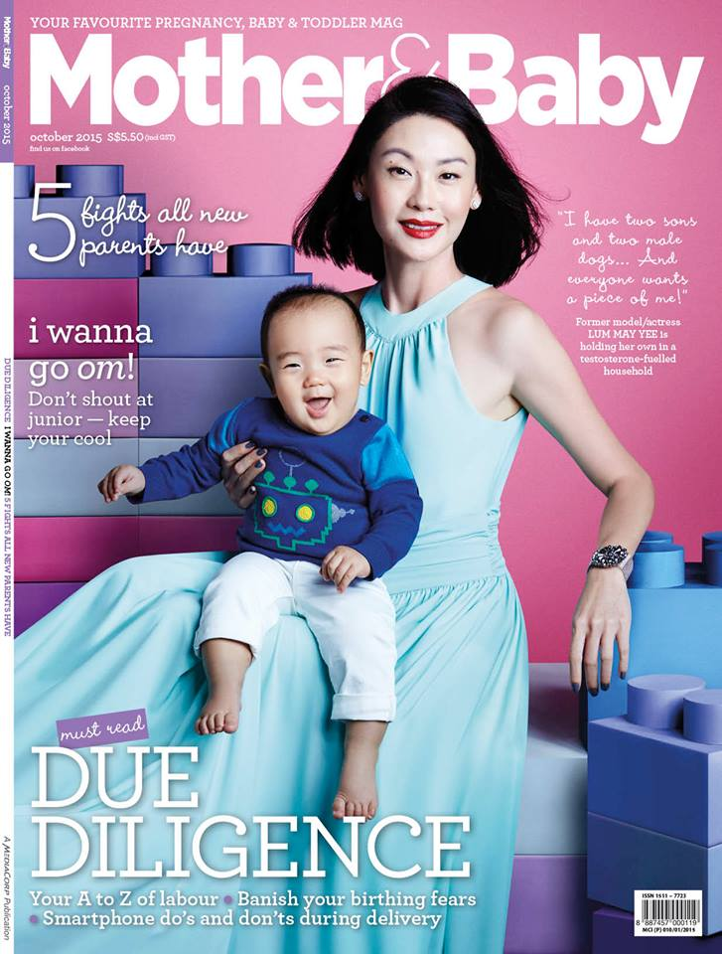
Cultural motherhood
The primacy of the biological mother-child bond
Despite their increased participation in the paid labor force, mothers in postindustrial societies are more invested and involved in the day-to-to lives of their children than are fathers
Women in our culture are still socialized to value the rewards of motherhood and to believe that having children is a primary source of self-identity
Notes:
No known society which mothers do not do majority of infant and childcare.
Mothers are more invested and more emotionally involved

Slide 20

Reproductive surveillance
Current attitudes and constructions of women and reproduction deny a pregnant woman of ownership of her own body
The media engages audiences in an exercise of passing judgment on what is good mothering
Extensive studies are conducted on the advisability of taking vitamins, using drugs, eating certain foods, exercising, and so on
Notes:
Public judgement on what is good for mothering.

Slide 21
Working mothers and the guilt gap
Kathleen Gerson’s (1985) Hard Choices: How Women Decide about Work, Career and Motherhood
The experiences of the women were diverse
But all faced difficult decisions about how to balance family and work
Cultural ambivalence regarding how mothers ought to behave
Images of stay-at-home mother versus working mother
Both images are considered socially acceptable but both are also indicted for their failings
These images lead many women to feel less than adequate
Notes:
If u are a stay-home mother then u are judged for not working
If u are a working mother then u are judged for being uncommitted to ur job or to not take care of the children.

Slide 22
Working mothers and the guilt gap
Ideology of the separate spheres
In contrast to fathers, mothers have to justify why they are working outside the home
In contrast to fathers, there is extensive research that focus on the difficulties women have in juggling the demands of family and work and on the negative effects of mothers’ employment on their children’s wellbeing
In contrast to fathers, mothers do not feel completely self-confident in their choice to enter or remain in the paid labor force
Guilt gap
Gender difference in the amount of concern men and women express over the effect their employment will have on their children
Notes:
Man do not have to explain why need to work while women needs to explain why she works instead of taking care of the family
Women’s employment are potentially damaging to family live, and need to justify why they want to work outside the home.
“negative effect of working father on children” – almost never seen in the academic world.
Cultural pressures to women as they can choose, and men have no choice but to work.

Slide 23
Gender and parenthood: fathers

Slide 24
From separate spheres to the baby boom
In the 18th century, fathers rather than mothers were considered the primary parents
Men who could do much of their work in the house were active in the nurturing and educational functions we now associate with motherhood
The Industrial Revolution of the 19th century and the separation of home and work created physical as well as emotional distance between fathers and children
The male role in the family became defined primarily as that of the breadwinner
During the baby boom period of the 1950s, there was renewed interest in father-child relationships
Fathers were believed to play an important, but complementary role
This stemmed from concerns about appropriate gender-role socialization
Father need to be at home so that they can be role models for their sons

Slide 25
An emerging image of fatherhood
Men started to show more interest in fatherhood in the latter half of the twentieth century
However, the cultural ideology of fatherhood – our beliefs about what fathers should do and what we would like them to do – has changed more rapidly than the conduct of fatherhood – what fathers actually do
The workplace still discourages men from completely abandoning the breadwinner role
Notes:
Breadwinner is associated with masculinity

Slide 26
Is the male breadwinning role disappearing?
Kathleen Gerson (1993) interviewed 138 men ranging in age from the late 20s to the mid-40s
Less than half remained committed to the traditional male breadwinner role and expected women to occupy the traditional female homemaker role
Changes in women’s lives had not, or should not, change men’s traditional status as dominant breadwinner
46% of the remainder cited freedom from the breadwinner role as a reason to renounce marriage and parenthood
Becoming responsible for a family would rob them of the option to pursue unpredictable careers or nontraditional jobs
15% saw the opportunity to embrace a more nurturing parent role and construct a marriage based on equality and fairness
A deep emotional attachment to their children and devoted much of their time at home to their care
Notes:
Kathleen Gerson (1993) No Man's Land: Men's Changing Commitments To Family And Work.

Slide 27
Is the male breadwinning role disappearing?
Rosanna Hertz (1999) observes the significance of social class in a group of family-focused fathers in dual-earner families
Some men came to the decision to put their families above their work commitments indirectly
These men tended to be working –class men who found themselves unemployed or underemployed
Their wives, by necessity, worked fulltime or overtime
Because they were committed to keeping the family central to their lives, these fathers stepped up their involvement and were able to master the parenting role
Other men consciously made the decision to put their families above their work commitments
These men tended to hold managerial and professional positions
They were able to negotiate flexible hours or reduced workweeks in order to spend more time with their families
Notes:
Rosanna Hertz (1999) “Working to Place Family at the Center of Life: Dual-Earner and Single-Parent Strategies.” The ANNALS of the American Academy of Political and Social Science, 562 (1), pp. 16-31.
Paradoxical period for the fatherhood role. Workplace roles difficult for man to engage in home and women to engage in work

Slide 28
Summary
The cultural primacy of biological parenthood persists despite the growing recognition that emotional bonds can be as strong as genetic ones
Parenthood itself continues to be presented as a joyous, valuable and normal experience but it is looked upon with ambivalence in the workplace
Women are still expected to place motherhood at the top of their list of priorities but more women are rejecting the notion that becoming a mother is necessary for their emotional fulfilment
The importance of fathers in children’s lives is widely acknowledged today but men are still drawn by the unambiguous rewards of the traditional breadwinner role

